Slide 1


Big Data Infrastructure
CS 489/698 Big Data Infrastructure (Winter 2016)
Week 12: Real-Time Data Analytics (2/2)
March 31, 2016
Jimmy Lin
David R. Cheriton School of Computer Science
University of Waterloo
These slides are available at http://lintool.github.io/bigdata-2016w/
This work is licensed under a Creative Commons Attribution-Noncommercial-Share Alike 3.0 United States See http://creativecommons.org/licenses/by-nc-sa/3.0/us/ for details

Slide 2
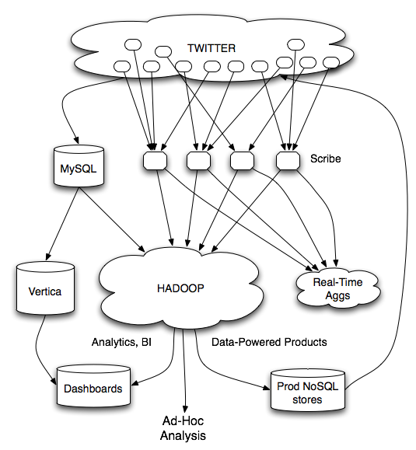
What’s the issue?
Twitter’s data warehousing architecture

Slide 3
Hashing for Three Common Tasks
Cardinality estimation
What’s the cardinality of set S?
How many unique visitors to this page?
Set membership
Is x a member of set S?
Has this user seen this ad before?
Frequency estimation
How many times have we observed x?
How many queries has this user issued?
HashSet
HLL counter
HashSet
Bloom Filter
HashMap
CMS

Slide 4
HyperLogLog Counter
Task: cardinality estimation of set
size() → number of unique elements in the set
Observation: hash each item and examine the hash code
On expectation, 1/2 of the hash codes will start with 1
On expectation, 1/4 of the hash codes will start with 01
On expectation, 1/8 of the hash codes will start with 001
On expectation, 1/16 of the hash codes will start with 0001
…
How do we take advantage of this observation?

Slide 5
Bloom Filters
Task: keep track of set membership
put(x) → insert x into the set
contains(x) → yes if x is a member of the set
Components
m-bit bit vector
k hash functions: h₁ … h_{k}
0
0
0
0
0
0
0
0
0
0
0
0

Slide 6
Bloom Filters: put
put
x
h₁(x) = 2
h₂(x) = 5
h₃(x) = 11
0
0
0
0
0
0
0
0
0
0
0
0

Slide 7
Bloom Filters: put
put
x
0
1
0
0
1
0
0
0
0
0
1
0

Slide 8
Bloom Filters: contains
contains
x
h₁(x) = 2
h₂(x) = 5
h₃(x) = 11
0
1
0
0
1
0
0
0
0
0
1
0

Slide 9
Bloom Filters: contains
contains
x
h₁(x) = 2
h₂(x) = 5
h₃(x) = 11
A[h₁(x)]
A[h₂(x)]
AND = YES
A[h₃(x)]
0
1
0
0
1
0
0
0
0
0
1
0

Slide 10
Bloom Filters: contains
contains
y
h₁(y) = 2
h₂(y) = 6
h₃(y) = 9
0
1
0
0
1
0
0
0
0
0
1
0

Slide 11
Bloom Filters: contains
contains
y
h₁(y) = 2
h₂(y) = 6
h₃(y) = 9
A[h₁(y)]
A[h₂(y)]
AND = NO
A[h₃(y)]
0
1
0
0
1
0
0
0
0
0
1
0
What’s going on here?

Slide 12
Bloom Filters
Error properties: contains(x)
False positives possible
No false negatives
Usage:
Constraints: capacity, error probability
Tunable parameters: size of bit vector m, number of hash functions k

Slide 13
Count-Min Sketches
Task: frequency estimation
put(x) → increment count of x by one
get(x) → returns the frequency of x
Components
k hash functions: h₁ … h_{k}
m by k array of counters
m
0
0
0
0
0
0
0
0
0
0
0
0
0
0
0
0
0
0
0
0
0
0
0
0
k
0
0
0
0
0
0
0
0
0
0
0
0
0
0
0
0
0
0
0
0
0
0
0
0

Slide 14
Count-Min Sketches: put
put
x
h₁(x) = 2
h₂(x) = 5
h₃(x) = 11
h₄(x) = 4
0
0
0
0
0
0
0
0
0
0
0
0
0
0
0
0
0
0
0
0
0
0
0
0
0
0
0
0
0
0
0
0
0
0
0
0
0
0
0
0
0
0
0
0
0
0
0
0

Slide 15
Count-Min Sketches: put
put
x
0
1
0
0
0
0
0
0
0
0
0
0
0
0
0
0
1
0
0
0
0
0
0
0
0
0
0
0
0
0
0
0
0
0
1
0
0
0
0
1
0
0
0
0
0
0
0
0

Slide 16
Count-Min Sketches: put
put
x
h₁(x) = 2
h₂(x) = 5
h₃(x) = 11
h₄(x) = 4
0
1
0
0
0
0
0
0
0
0
0
0
0
0
0
0
1
0
0
0
0
0
0
0
0
0
0
0
0
0
0
0
0
0
1
0
0
0
0
1
0
0
0
0
0
0
0
0

Slide 17
Count-Min Sketches: put
put
x
0
2
0
0
0
0
0
0
0
0
0
0
0
0
0
0
2
0
0
0
0
0
0
0
0
0
0
0
0
0
0
0
0
0
2
0
0
0
0
2
0
0
0
0
0
0
0
0

Slide 18
Count-Min Sketches: put
put
y
h₁(y) = 6
h₂(y) = 5
h₃(y) = 12
h₄(y) = 2
0
2
0
0
0
0
0
0
0
0
0
0
0
0
0
0
2
0
0
0
0
0
0
0
0
0
0
0
0
0
0
0
0
0
2
0
0
0
0
2
0
0
0
0
0
0
0
0

Slide 19
Count-Min Sketches: put
put
y
0
2
0
0
0
1
0
0
0
0
0
0
0
0
0
0
3
0
0
0
0
0
0
0
0
0
0
0
0
0
0
0
0
0
2
1
0
1
0
2
0
0
0
0
0
0
0
0

Slide 20
Count-Min Sketches: get
get
x
h₁(x) = 2
h₂(x) = 5
h₃(x) = 11
h₄(x) = 4
0
2
0
0
0
1
0
0
0
0
0
0
0
0
0
0
3
0
0
0
0
0
0
0
0
0
0
0
0
0
0
0
0
0
2
1
0
1
0
2
0
0
0
0
0
0
0
0

Slide 21
Count-Min Sketches: get
get
x
h₁(x) = 2
h₂(x) = 5
h₃(x) = 11
h₄(x) = 4
A[h₁(x)]
A[h₂(x)]
MIN = 2
A[h₃(x)]
A[h₄(x)]
0
2
0
0
0
1
0
0
0
0
0
0
0
0
0
0
3
0
0
0
0
0
0
0
0
0
0
0
0
0
0
0
0
0
2
1
0
1
0
2
0
0
0
0
0
0
0
0

Slide 22
Count-Min Sketches: get
get
y
h₁(y) = 6
h₂(y) = 5
h₃(y) = 12
h₄(y) = 2
0
2
0
0
0
1
0
0
0
0
0
0
0
0
0
0
3
0
0
0
0
0
0
0
0
0
0
0
0
0
0
0
0
0
2
1
0
1
0
2
0
0
0
0
0
0
0
0

Slide 23
Count-Min Sketches: get
get
y
h₁(y) = 6
h₂(y) = 5
h₃(y) = 12
h₄(y) = 2
A[h₁(y)]
A[h₂(y)]
MIN = 1
A[h₃(y)]
A[h₄(y)]
0
2
0
0
0
1
0
0
0
0
0
0
0
0
0
0
3
0
0
0
0
0
0
0
0
0
0
0
0
0
0
0
0
0
2
1
0
1
0
2
0
0
0
0
0
0
0
0

Slide 24
Count-Min Sketches
Error properties:
Reasonable estimation of heavy-hitters
Frequent over-estimation of tail
Usage:
Constraints: number of distinct events, distribution of events, error bounds
Tunable parameters: number of counters m, number of hash functions k, size of counters

Slide 25
Three Common Tasks
Cardinality estimation
What’s the cardinality of set S?
How many unique visitors to this page?
Set membership
Is x a member of set S?
Has this user seen this ad before?
Frequency estimation
How many times have we observed x?
How many queries has this user issued?
HashSet
HLL counter
HashSet
Bloom Filter
HashMap
CMS

Slide 26

Stream Processing Architectures
Source: Wikipedia (River)

Slide 27
Producer/Consumers
Producer
Consumer
How do consumers get data from producers?

Slide 28
Producer/Consumers
Producer
Consumer
Producer pushes
e.g., callback

Slide 29
Producer/Consumers
Producer
Consumer
Consumer pulls
e.g., poll, tail

Slide 30
Producer/Consumers
Consumer
Producer
Consumer
Producer
Consumer
Consumer

Slide 31
Producer/Consumers
Consumer
Producer
Kafka
Broker
Consumer
Producer
Consumer
Consumer
Queue, Pub/Sub

Slide 32
Tuple-at-a-Time Processing

Slide 33
Storm
Open-source real-time distributed stream processing system
Started at BackType
BackType acquired by Twitter in 2011
Now an Apache project
Storm aspires to be the Hadoop of real-time processing!

Slide 34
Storm Topologies
Storm topologies = “job”
Once started, runs continuously until killed
A Storm topology is a computation graph
Graph contains nodes and edges
Nodes hold processing logic (i.e., transformation over its input)
Directed edges indicate communication between nodes
Processing semantics:
At most once: without acknowledgments
At least once: with acknowledgements

Slide 35
Streams, Spouts, and Bolts
Streams
The basic collection abstraction: an unbounded sequence of tuples
Streams are transformed by the processing elements of a topology
spout
spout
stream
bolt
bolt
bolt
Spouts
Stream generators
May propagate a single stream to multiple consumers
bolt
bolt
spout
Bolts
Subscribe to streams
Streams transformers
Process incoming streams and produce new ones
stream
stream
bolt
bolt

Slide 36
Stream Groupings
Bolts are executed by multiple workers in parallel
When a bolt emits a tuple, where should it go?
Stream groupings:
Shuffle grouping: round-robin
Field grouping: based on data value

Slide 37
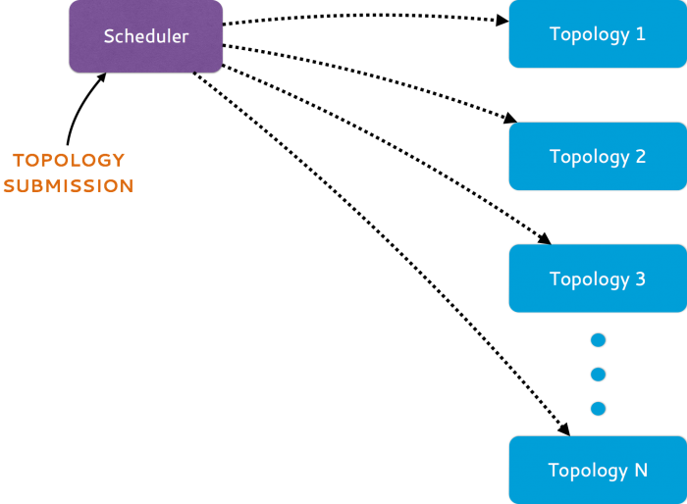
From Storm to Heron
Heron = API compatible re-implementation of Storm
Source: https://blog.twitter.com/2015/flying-faster-with-twitter-heron

Slide 38
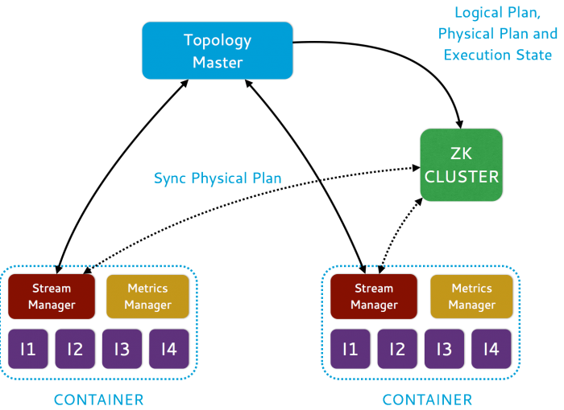
Source: https://blog.twitter.com/2015/flying-faster-with-twitter-heron

Slide 39
Mini-Batch Processing

Slide 40
Discretized Stream Processing
Run a streaming computation as a series of very small, deterministic batch jobs
live data stream
Spark
Streaming
Chop up the live stream into batches of X seconds
Spark treats each batch of data as RDDs and processes them using RDD operations
Finally, the processed results of the RDD operations are returned in batches
batches of X seconds
Spark
processed results
Source: All following Spark Streaming slides by Tathagata Das

Slide 41
Discretized Stream Processing
Run a streaming computation as a series of very small, deterministic batch jobs
live data stream
Spark
Streaming
Batch sizes as low as ½ second, latency ~ 1 second
Potential for combining batch processing and streaming processing in the same system
batches of X seconds
Spark
processed results

Slide 42

Example: Get hashtags from Twitter
val tweets = ssc.twitterStream(<Twitter username>, <Twitter password>)
DStream: a sequence of RDD representing a stream of data
Twitter Streaming API
batch @ t+1
batch @ t
batch @ t+2
tweets DStream
stored in memory as an RDD (immutable, distributed)

Slide 43
Example: Get hashtags from Twitter
val tweets = ssc.twitterStream(<Twitter username>, <Twitter password>)
val hashTags = tweets.flatMap (status => getTags(status))
new DStream
transformation: modify data in one Dstream to create another DStream
batch @ t
batch @ t+1
batch @ t+2
tweets DStream
flatMap
flatMap
flatMap
hashTags Dstream
[#cat, #dog, … ]
…
new RDDs created for every batch

Slide 44

Example: Get hashtags from Twitter
val tweets = ssc.twitterStream(<Twitter username>, <Twitter password>)
val hashTags = tweets.flatMap (status => getTags(status))
hashTags.saveAsHadoopFiles("hdfs://...")
output operation: to push data to external storage
batch @ t
batch @ t+1
batch @ t+2
tweets DStream
flatMap
flatMap
flatMap
hashTags DStream
save
save
save
every batch saved to HDFS

Slide 45
Fault-tolerance
RDDs are remember the sequence of operations that created it from the original fault-tolerant input data
Batches of input data are replicated in memory of multiple worker nodes, therefore fault-tolerant
Data lost due to worker failure, can be recomputed from input data
tweets
RDD
input data replicated
in memory
flatMap
hashTags
RDD
lost partitions recomputed on other workers

Slide 46
Key concepts
DStream – sequence of RDDs representing a stream of data
Twitter, HDFS, Kafka, Flume, ZeroMQ, Akka Actor, TCP sockets
Transformations – modify data from on DStream to another
Standard RDD operations – map, countByValue, reduce, join, …
Stateful operations – window, countByValueAndWindow, …
Output Operations – send data to external entity
saveAsHadoopFiles – saves to HDFS
foreach – do anything with each batch of results

Slide 47
Example: Count the hashtags
val tweets = ssc.twitterStream(<Twitter username>, <Twitter password>)
val hashTags = tweets.flatMap (status => getTags(status))
val tagCounts = hashTags.countByValue()
batch @ t
batch @ t+1
batch @ t+2
tweets
flatMap
flatMap
flatMap
hashTags
map
map
…
map
tagCounts
[(#cat, 10), (#dog, 25), ... ]
reduceByKey
reduceByKey
reduceByKey

Slide 48
Example: Count the hashtags over last 10 mins
val tweets = ssc.twitterStream(<Twitter username>, <Twitter password>)
val hashTags = tweets.flatMap (status => getTags(status))
val tagCounts = hashTags.window(Minutes(10), Seconds(1)).countByValue()
sliding window operation
window length
sliding interval

Slide 49
Example: Count the hashtags over last 10 mins
val tagCounts = hashTags.window(Minutes(10), Seconds(1)).countByValue()
t-1
t
t+1
t+2
t+3
hashTags
sliding window
countByValue
count over all the data in the window
tagCounts

Slide 50
Smart window-based countByValue
val tagCounts = hashtags.countByValueAndWindow(Minutes(10), Seconds(1))
t-1
t
t+1
t+2
t+3
hashTags
countByValue
add the counts from the new batch in the window
subtract the counts from batch before the window
–
+
tagCounts
+
?

Slide 51
Smart window-based reduce
Technique to incrementally compute count generalizes to many reduce operations
Need a function to “inverse reduce” (“subtract” for counting)
Could have implemented counting as:
hashTags.reduceByKeyAndWindow(_ + _, _ - _, Minutes(1), …)

Slide 52
Integrating Batch and Online Processing

Slide 53

Summingbird
A domain-specific language (in Scala) designed
to integrate batch and online MapReduce computations
Idea #1: Algebraic structures provide the basis for seamless integration of batch and online processing
Idea #2: For many tasks, close enough is good enough
Probabilistic data structures as monoids

Slide 54
Batch and Online MapReduce
“map”
flatMap[T, U](fn: T => List[U]): List[U]
map[T, U](fn: T => U): List[U]
filter[T](fn: T => Boolean): List[T]
“reduce”
sumByKey

Slide 55
Idea #1: Algebraic structures provide the basis for seamless integration of batch and online processing
Semigroup = ( M , ⊕ )
⊕ : M × M → M, s.t., ∀m₁, m₂, m₃ ∋ M
(m₁ ⊕ m₂) ⊕ m₃ = m₁ ⊕ (m₂ ⊕ m₃)
Monoid = Semigroup + identity
ε s.t., ε ⊕ m = m ⊕ ε = m, ∀m ∋ M
Commutative Monoid = Monoid + commutativity
∀m₁, m₂ ∋ M, m₁ ⊕ m₂ = m₂ ⊕ m₁
Simplest example: integers with + (addition)

Slide 56
Idea #1: Algebraic structures provide the basis for seamless integration of batch and online processing
Summingbird values must be at least semigroups (most are commutative monoids in practice)
Power of associativity =
You can put the parentheses anywhere!
( a ⊕ b ⊕ c ⊕ d ⊕ e ⊕ f )
Batch = Hadoop
((((( a ⊕ b ) ⊕ c ) ⊕ d ) ⊕ e ) ⊕ f )
Online = Storm
(( a ⊕ b ⊕ c ) ⊕ ( d ⊕ e ⊕ f ))
Mini-batches
Results are exactly the same!

Slide 57
Summingbird Word Count
where data comes from
def wordCount[P <: Platform[P]]
(source: Producer[P, String],
store: P#Store[String, Long]) =
source.flatMap { sentence =>
toWords(sentence).map(_ -> 1L)
}.sumByKey(store)
where data goes
“map”
“reduce”
Run on Scalding (Cascading/Hadoop)
read from HDFS
Scalding.run {
wordCount[Scalding](
Scalding.source[Tweet]("source_data"),
Scalding.store[String, Long]("count_out")
)
}
write to HDFS
Run on Storm
Storm.run {
wordCount[Storm](
new TweetSpout(),
new MemcacheStore[String, Long]
)
}
read from message queue
write to KV store

Slide 58
Input
Input
Input
Spout
Map
Map
Map
Bolt
Bolt
Bolt
Reduce
Reduce
Bolt
Bolt
Output
Output
memcached

Slide 59
“Boring” monoids
addition, multiplication, max, min
moments (mean, variance, etc.)
sets
tuples of monoids
hashmaps with monoid values
More interesting monoids?

Slide 60
Idea #2: For many tasks, close enough is good enough!
“Interesting” monoids
Bloom filters (set membership)
HyperLogLog counters (cardinality estimation)
Count-min sketches (event counts)
Common features
1. Variations on hashing
2. Bounded error

Slide 61
Cheat sheet
Exact
Approximate
Set membership
set
Bloom filter
Set cardinality
set
hyperloglog counter
Frequency count
hashmap
count-min sketches

Slide 62
Task: count queries by hour
Exact with hashmaps
def wordCount[P <: Platform[P]]
(source: Producer[P, Query],
store: P#Store[Long, Map[String, Long]]) =
source.flatMap { query =>
(query.getHour, Map(query.getQuery -> 1L))
}.sumByKey(store)
Approximate with CMS
def wordCount[P <: Platform[P]]
(source: Producer[P, Query],
store: P#Store[Long, SketchMap[String, Long]])
(implicit countMonoid: SketchMapMonoid[String, Long]) =
source.flatMap { query =>
(query.getHour,
countMonoid.create((query.getQuery, 1L)))
}.sumByKey(store)

Slide 63
Hybrid Online/Batch Processing
Example: count historical clicks and clicks in real time
Message Queue
read
Storm topology
write
online results key-value store
query
client
online
Summingbird
program
client library
batch
Hadoop job
batch results key-value store
query
ingest
HDFS
read
write
source₁
source₂
source₃
…
store₁
store₂
store₃
…

Slide 64

Questions?
Source: Wikipedia (Japanese rock garden)

